Slide 1
Tense
PEL125_ Week 1

Slide 2
Present Simple Tense
1. We use the present simple to describe things that are always true, or situations that exist now and, as far as we know, will go on indefinitely:
It takes me five minutes to get to school.
Trees grow more quickly in summer than in winter.
Liz plays the violin brilliantly.

Slide 3
2. We use the present simple to talk about habits or things that happen on a regular basis:
I leave work at 5.30 most days.
Each July we go to Turkey for a holiday.

Slide 4
3. We often use the present simple with verbs that perform the action they describe:
I admit I can't see as well as I used to. (= an admission)
I refuse to believe that he didn't know the car was stolen. (= a refusal)
Other verbs like this (sometimes called performative verbs) include accept, acknowledge, advise, apologise, assume, deny, guarantee, hope, inform, predict, promise, recommend, suggest, suppose, warn.

Slide 5
4. We use the present simple to describe something that we regularly do at a particular time.
We usually watch the news on TV at 9.00. (= we start watching at 9.00)

Slide 6
Present Continuous Tense
1. To talk about particular actions or events that have begun but have not ended at the time of speaking,
For e.g.
The car isn't starting again.
'Who are you phoning?' 'I'm trying to get through to Joan.'
We often use time expressions such as at the moment, at present, currently, just, and still to emphasise that the action or event is happening now:

Slide 7
2. When we describe repeated actions or events that are happening at or around the time of speaking, we use the present continuous:
Why are you jumping up and down?
I'm hearing a lot of good reports about your work these days.

Slide 8
3. We use the present continuous to imply that a situation is or may be temporary.
We're usually watching the news on TV at 9.00. (= we're already watching at 9.00)
Banks are lending more money (these days) to encourage businesses to expand, (implies a temporary arrangement)

Slide 9
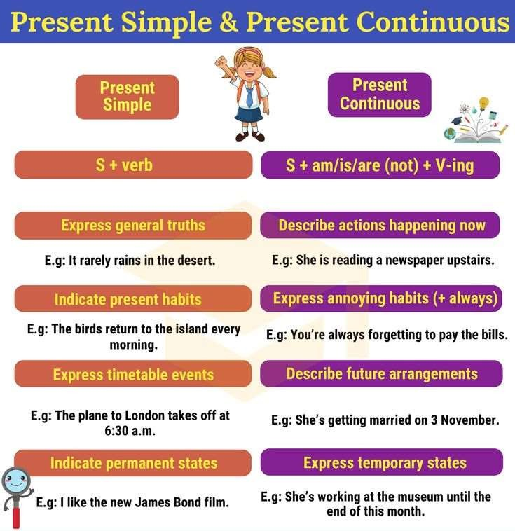

Slide 10
We often prefer to use the present simple rather than the present continuous with verbs describing states:
I really enjoy travelling.
The group currently consists of five people, but we hope to get more members soon.
Common state verbs:
agree, assume, believe, belong to, contain, cost, disagree, feel, hate, have, hope, know, like, look, love, own, prefer, realise, regret, resemble, smell, taste etc.

Slide 11
Exception
We can use the present continuous with some state verbs when we want to emphasise that a situation is temporary, for a period of time around the present. Compare:
I consider him to be extremely fortunate. (This is my view) and
I'm considering taking early retirement. (This is something I'm thinking about now)

Slide 12
We use the present continuous when we talk about changes, developments, and trends:
The growing number of visitors is damaging the footpaths.
I'm beginning to realise how difficult it is to be a teacher.
While telling a story/joke, we often describe the main events using the present (or past) simple and longer, background events using the present (or past) continuous:
She goes (or went) up to this man and looks (or looked) straight into his eyes. She's carrying (or was carrying) a bag full of shopping...

Slide 13
We use the present simple and present continuous in commentaries (for example, on sports events) and in giving instructions:
King serves to the left hand court and Adams makes a wonderful return. She's playing magnificent tennis in this match...
You hold the can in one hand. Right, you're holding it in one hand; now you take off the lid with the other.

Slide 14
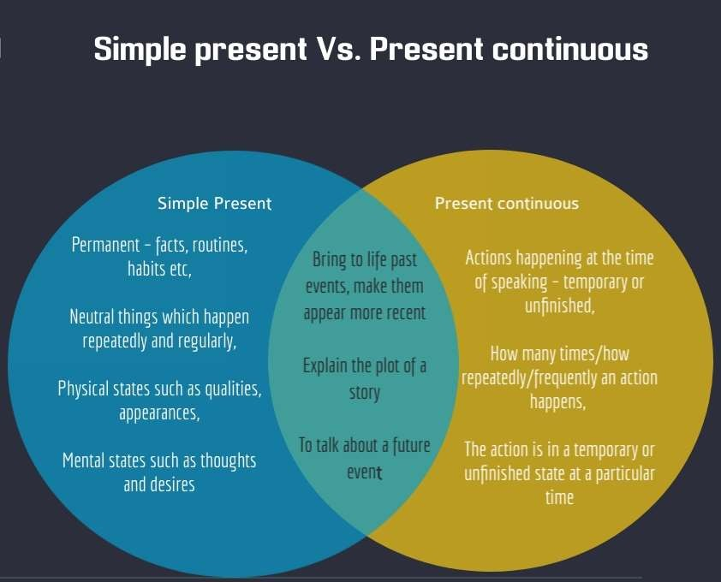

Slide 15
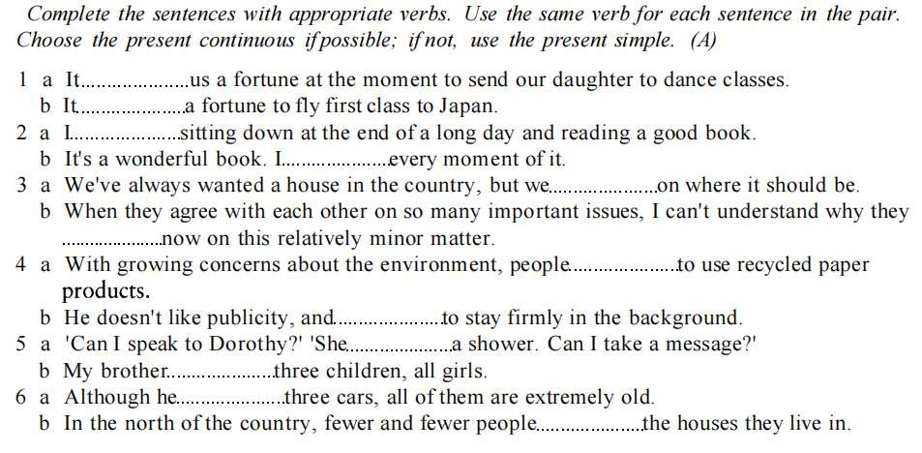

Slide 16
Uses of Present Perfect
1. Actions started in the past and continuing in the present
They haven't lived here for years.
She has worked in the bank for five years.
Have you played the piano since you were a child?
2. When the time period referred to has not finished
I have worked hard this week.
It has rained a lot this year.
We haven't seen her today.

Slide 17
Actions repeated in an unspecified period between the past and now.
They have seen that film six times
It has happened several times already.
Actions completed in the very recent past (+just)
Have you just finished work?
I have just eaten.

Slide 18
When the precise time of the action is not important or not known
Someone has eaten my soup!
Have you seen 'Gone with the Wind'?

Slide 19
We use the past tense to talk about:
1. something that happened once in the past:
I met my wife in 1983.
We went to Spain for our holidays.
They got home very late last night.
2. something that happened several times in the past:
When I was a boy, I walked a mile to school every day.
We swam a lot while we were on holiday.
They always enjoyed visiting their friends.

Slide 20
3. something that was true for some time in the past:
I lived abroad for ten years.
He enjoyed being a student.
She played a lot of tennis when she was younger.

Slide 21








SIMPLE PAST TENSE
PRESENT PERFECT TENSE

Slide 22
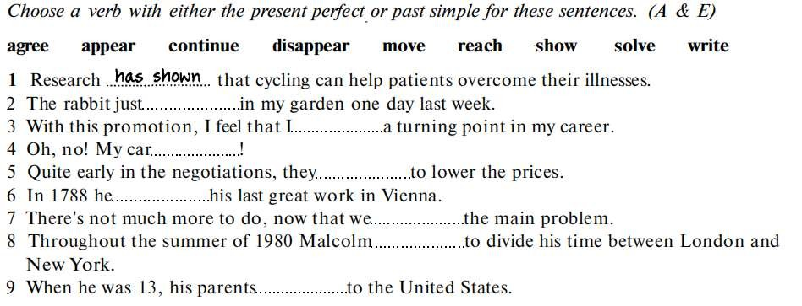

Slide 23
Exceptions
We use the present perfect when we talk about something that happened in a period of time up to the present.
e.g. Science has made many major advances this century,
We use the past simple to talk about something that happened at a particular, finished time in the past.
e.g. Scientists made some fundamental discoveries in the 18th century

Slide 24
We can use either the present perfect or the past simple to talk about repeated actions or events.
To suggest that the action or event might happen again, we use the present perfect. Example : Timson has made 13 films and I think her latest is the best
To suggest that it is finished and won't happen again, we use
simple past tense
Example : Timson made 13 films before she was tragically killed in a car accident

Slide 25
We use the present perfect to talk about a state that existed in the past and still exists now.
I have known him most of my working life. (I am still working)
We use the past simple if the state no longer exists.
• I knew him when we were both working in Rome

Slide 26
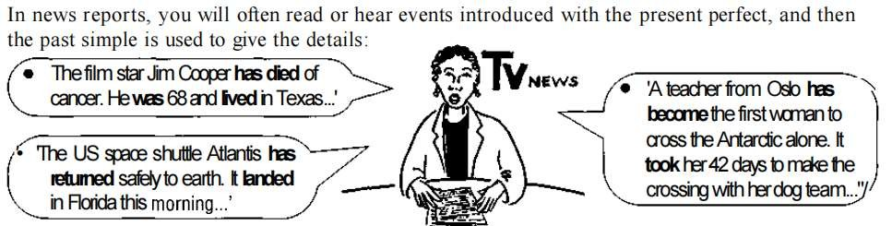

Slide 27
Simple Past and Past Perfect
We use the past simple rather than the past perfect when we simply talk about a single activity or event in the past:
I handed the letter to him.
We use the past perfect when we say what we wanted or hoped (etc.) to do, but didn't:
e.g. : I had wanted to visit the gallery before I left Florence, but it's closed on Sundays.

Slide 28
When we use a time expression (e.g. after, as soon as, before, by the time (that), when) to say that one event happened after another,
we use past perfect for the event that happened first and the past simple for the event that happened second
E.g. After Ivan (had) finished reading, he put out the light.

Slide 29
Past Perfect continuous and Past Perfect
We use the past perfect continuous when we talk about the continuity or duration of a situation or activity, and the past perfect to talk about the completion of a situation or activity or its effects
If we talk about how long something went on up to a particular past time, we use the past perfect continuous.
If we talk about how many times something happened in a period up to a particular past time, we use the past perfect tense.

Slide 30
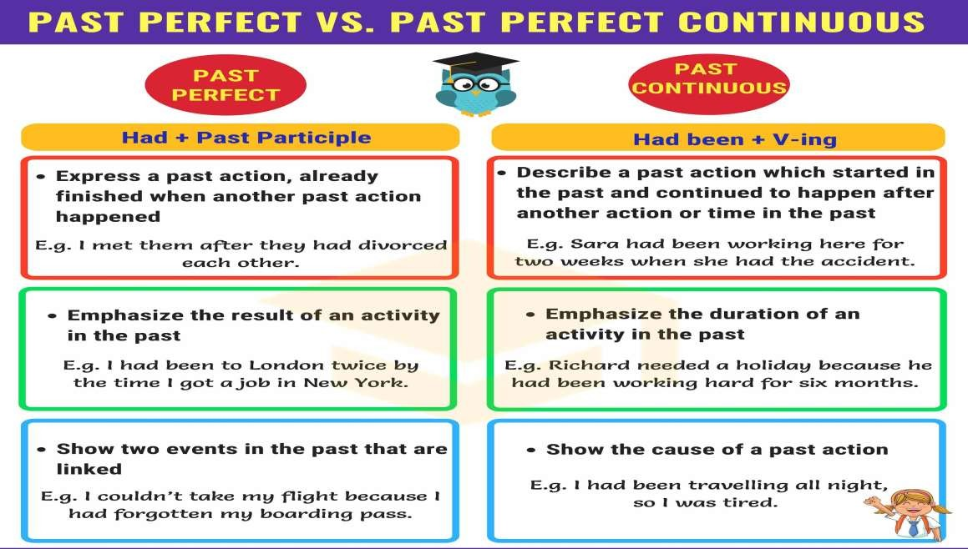

Slide 31


